Slide 1
Introduction to ai4math
Minicourse in Lean
Wang Yutong @ NUS

Slide 2
outline
Introduction to LLM
Techniques in LLM
In-context learning
Retrieval augmented generation
Chain of thought
Tool calling/Function calling
Demonstration
Application to Lean 4

Slide 3
Introduction to LLM

Slide 4
Introduction to LLM
Properties
Obstacles: too less data!

Slide 5
Introduction to llm
Muggle in Lean | Know a Little bit | Decent Understanding
GPT-4o, o1, o3, … Gemini 2.5/3 | Deepseek V3 Deepseek R1 Qwen 2.5 Math InternLM2.5 Llama 3.2/3.3 | Claude 3.5 Sonnet Claude 3.7 Sonnet

Slide 6
In-context learning
Techniques In LLM

Slide 7
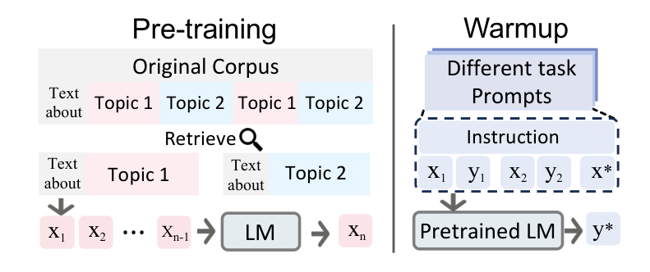
In-context learning
Feeding in examples in the inference period

Slide 8
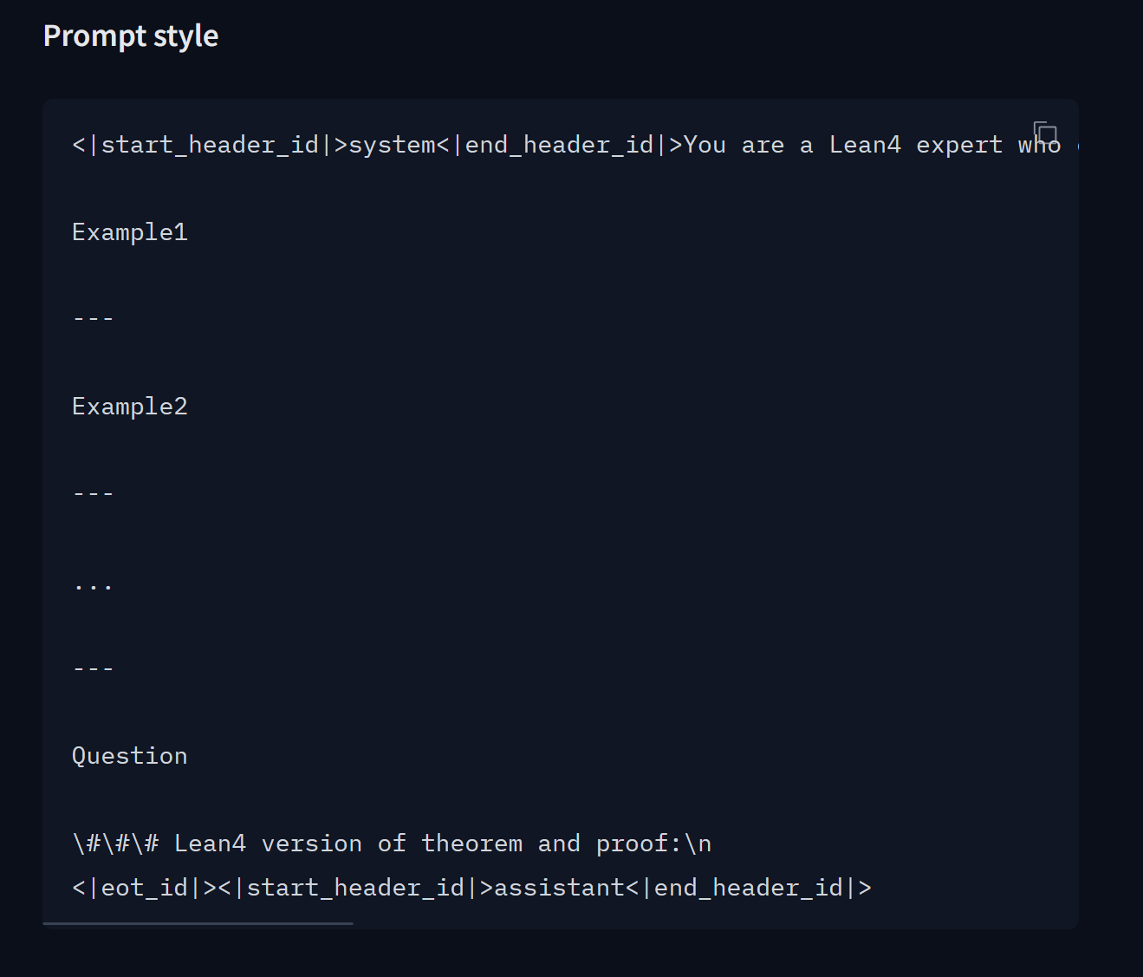
In-context learning
Demo
TheoremLlama: https://huggingface.co/RickyDeSkywalker/TheoremLlama

Slide 9
Retrieval Augmented gen

Slide 10
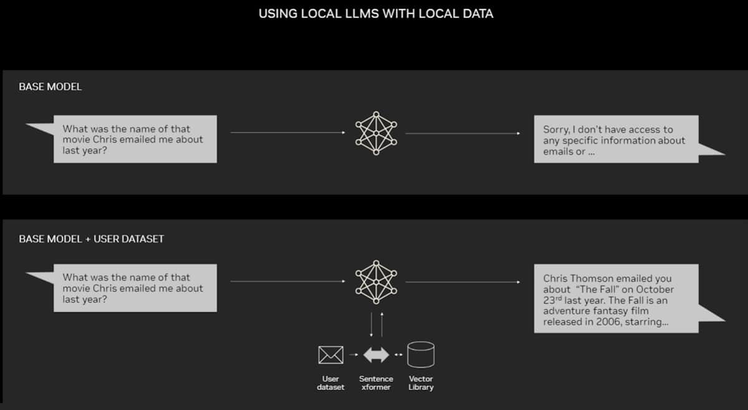
RAG
Medicine and Law

